Slide 1



Assalamu alailkum
Presentation done by Anika,Tahsin & Sukhi

Slide 2
WELCOME TO OUR CSE 1102 PRESENTATION ON OUR CREATING WEBSITE WITH HTML.
pRESENTED BY:
ANIKA TAHSIN FARIHA ID NO:180101012
TAHSIN ALAM CHOWDHURI ID NO:180101033
KHADIJATUL KOBRA SHUKIMONI ID NO:180101034

Slide 3
OUR WEBSITE NAME IS “HUMAYUN AHMED”

Slide 4

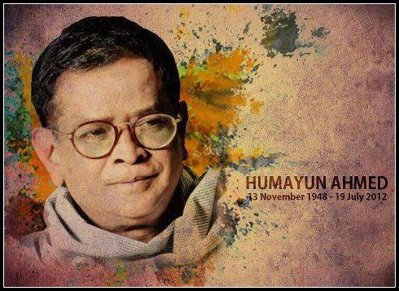
“’
“AWARDS &HONORS
WE CAN KNOW FROM THIS “HUMAYAN AHMED WEBSITE”.
“BIOGRAPHY”
“CREATIVE THINGS”
“BOOKS”
& KNOW MORE DETAIS ABOUT HIS WHOLE BIODATA.

Slide 5

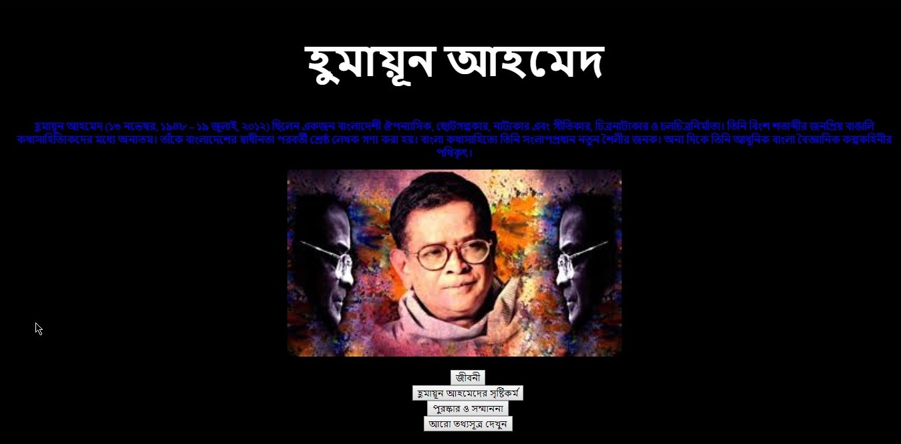
IT’S WEBSITE HOMEPAGE

Slide 6

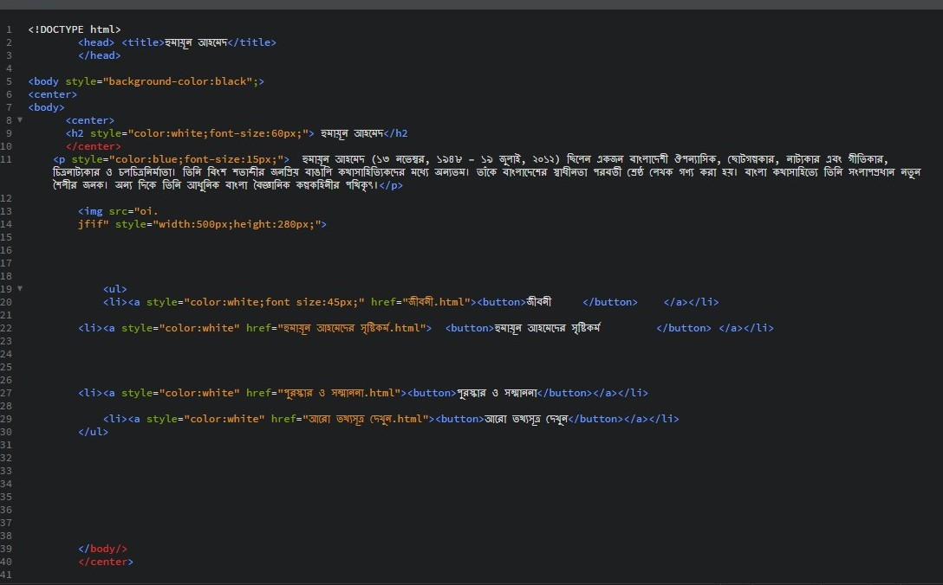
WE USED IN THIS WEBSITE SIMPLE TAGS…
They are: <h2>,<p>,<img>,<ul>,<li>,<a >,<button>& <center> tags…
HERE WE USED A CSS PROPERTY.
THIS TAG NAME IS “STYLE”
IT’S helps us creating different looking website with changing different font –size,font –color& background color.

Slide 7
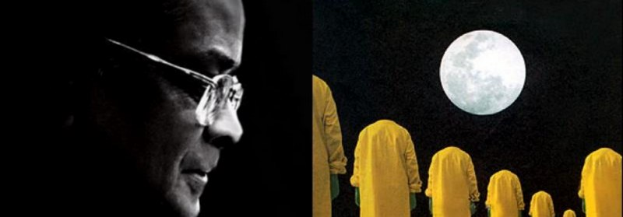
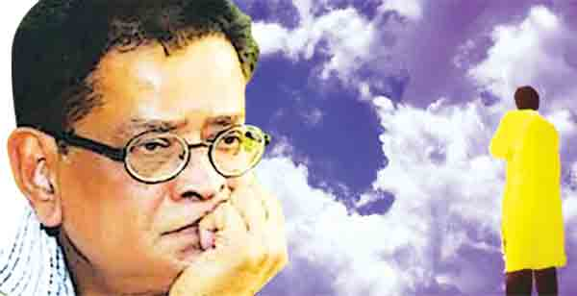
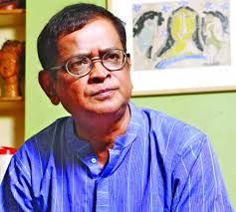
In this website we made about “HUMAYUN AHMED” because he is no more in our midst.
We always want to keep him alive in our midst & our next generation will be know his properly.

Slide 8
THE END
THANK you EVERYONE

